Slide 1
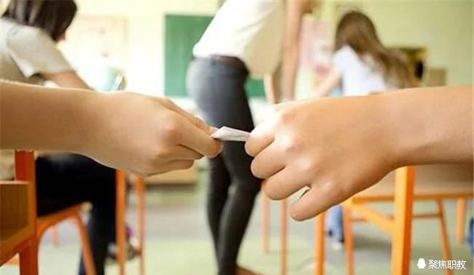

What’s Wrong with Schools?
Teacher Plays Student, Learns to
Lie and Cheat
Casey Banas

Slide 2
Detailed Understanding of the Text
1. A teacher pretends to be a student and sits in on several classes. What does she find in the typical class? Boredom. Routine. Apathy. Manipulation. Discouragement. If this depressing list sounds familiar, you will be interested in the following analysis of why classes often seem to be more about killing time than about learning. (Preview)
►Please translate the sentences into Chinese.

Slide 3
Detailed Understanding of the Text
2. The difference is that Ellen Glanz was a twenty-eight-year-old high school social studies teacher who was a student for six months to improve her teaching by gaining a fresh perspective of her school. (Para. 1)
►Please explain the phrase “gain a fresh perspetive of sth.” in English.

Slide 4
Detailed Understanding of the Text
3. She found many classes boring, students doing as little as necessary to pass tests and get good grades, students using ruses to avoid assignments, and students manipulating teachers to do the work for them. She concluded that many students are turned off because they have little power and responsibility for their own education. (Para. 2)
►Please explain the reddened words and phrases in English.
►What’s the grammatical fuction of the two “students doing”structures?

Slide 5
Detailed Understanding of the Text
4. She found a way out and confided: “I considered my options: Confess openly to the teacher, copy someone else’s sheet, or make up an excuse.” Glanz chose the third option—the one most widely used—and told the teacher that the pages needed to complete the assignment had been ripped from the book. (Para. 4)
►Please explain the reddened words and expressions in English.
►Please translate the sentences into Chinese.

Slide 6
Detailed Understanding of the Text
5. In class, nobody else did the homework; and student after student mumbled responses when called on. (Para. 4)
►Please paraphrase the sentence.

Slide 7
Detailed Understanding of the Text
6. “In many cases,” she said, “people simply didn’t do the work assignment, but copied from someone else or manipulated the teacher into doing the work for them.” (Para. 6)
►Please paraphrase the sentence.

Slide 8
Detailed Understanding of the Text
7. “The system encourages incredible passivity,” Glanz said. (Para. 7)
►Please paraphrase the sentence.

Slide 9
Detailed Understanding of the Text
8. “When I taught,” Glanz recalled, “my mind was going constantly—figuring out how to best present an idea, thinking about whom to call on, whom to draw out, whom to shut up; how to get students involved, how to make my point clearer, how to respond; when to be funny, when serious. As a student, I experienced little of this. (Para. 7)
►Please translate the sentences into Chinese.

Slide 10
Detailed Understanding of the Text
9. Class methods promote the feeling that students have little control over or responsibility for their own education because the agenda is the teacher’s, Glanz said. The teacher is convinced the subject matter is worth knowing, but the student may not agree. (Para. 8)
►Please explain the reddened words and expressions in English.

Slide 11
Detailed Understanding of the Text
10. Students, obsessed with getting good grades to help qualify for the college of their choice, believe the primary responsibility for their achievement rests with the teacher, Glanz said. (Para. 9)
►Please explain the reddened words and expressions in English.

Slide 12
Detailed Understanding of the Text
11. Teachers were regarded by students, Glanz said, not as “people,” but as “role-players” who dispensed information needed to pass a test. “I often heard students describing teachers as drips, bores, and numerous varieties of idiots,” she said. (Para. 10)
►Please explain the words and expressions in English.

Slide 13
Detailed Understanding of the Text
12. After seeing political corruption they conclude that honesty takes a back seat to getting ahead any way one can, she said. “I sometimes estimated that half to two-thirds of a class cheated on a given test,” Glanz said. “Worse, I’ve encountered students who feel no remorse about cheating but are annoyed that a teacher has confronted them on their actions.” (Para. 11)
►Explain the reddened words and expressions in English.
►Translate the sentences into Chinese.

Slide 14
Detailed Understanding of the Text
13. Before, she was quick to accept the excuses of students who came to class unprepared. Now she says, “You are responsible for learning it.” But a crackdown is only a small part of the solution. (Para. 12)
►Please paraphrase the sentences.

Slide 15
Detailed Understanding of the Text
14. The larger issue, Glanz said, is that educators must recognize that teachers and students, though physically in the same school, are in separate worlds and have an ongoing power struggle. (Para. 13)
►Please paraphrase the sentence.

Slide 16
Detailed Understanding of the Text
15. No longer, she emphasized, do students assume that “teacher knows best. (Para. 13)
►Please explain the sentence pattern.

